Slide 1
Hashing
Course Code: CSC 2106
Course Title: Data Structure (Theory)
Dept. of Computer Science
Faculty of Science and Technology
Lecture No: |  | Week No: |  | Semester:
Lecturer: | Email:

Slide 2
Lecture Outline
Hashing
Hashing Table
Division Hashing
Collision
Linear Probing

Slide 3
HASHING
A technique to map data to a fixed-size value (hash code).
Used to quickly locate or retrieve data in a collection.
A hash function converts a key into an integer (hash code).
Applications: Databases, Cryptography, Caching.

Slide 4
HASHING TABLE
A data structure that stores data in key-value pairs.
Uses a hash function to compute an index for storage.
Provides fast access, insertion, and deletion of data.
Average time complexity: O(1).

Slide 5
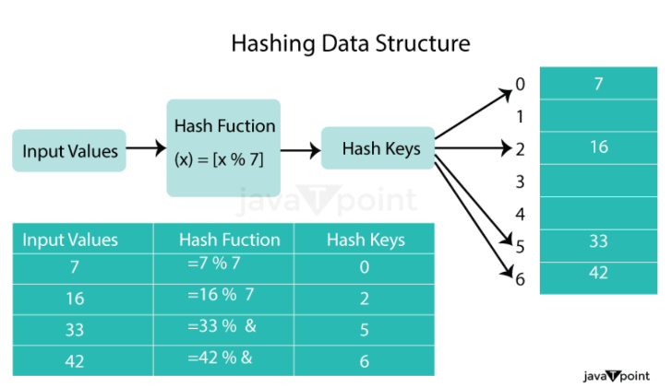
What is Division Hashing
Hash(Key) = Key % P, where,
P = Prime_Number or Table_Size or Any_Number
Prime numbers reduce clustering and improve distribution.

Slide 6
COLLISION
Example (no collision):
Keys: {10, 22, 34}, Prime: 7
Results:
10 % 7 = 3
22 % 7 = 1
34 % 7 = 6
Example (collision):
Keys: {10, 22, 31}, Prime: 7
Results:
10 % 7 = 3
22 % 7 = 1
31 % 7 = 3 (collision)
Collision occurs when two or more keys map to the same hash index.
Needs to be resolved to store all keys at unique index.
Common resolution techniques:
- Separate Chaining
- Open Addressing (e.g., Linear Probing, Quadratic Probing).

Slide 7
LINEAR PROBING
Collision resolution technique in Open Addressing.
If a collision occurs, checks next available slot linearly:
h'(k, i) = (h(k) + i) mod m
Advantages: Simple to implement.
Disadvantages: May cause clustering and degrade performance as the table fills.

Slide 8
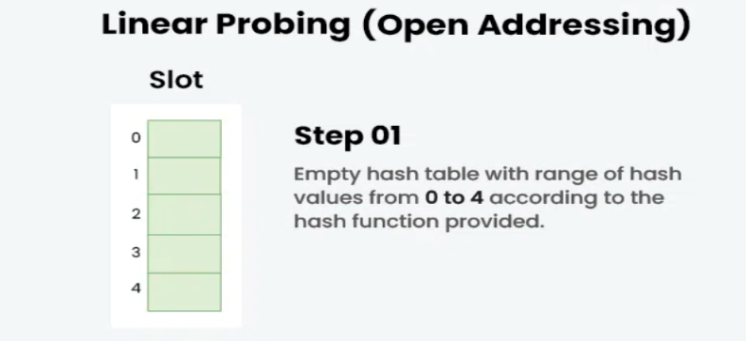
LINEAR PROBING: Example
Hash(Key) = Key % P
Keys: {50, 70, 76, 85, 93}, P = 5

Slide 9
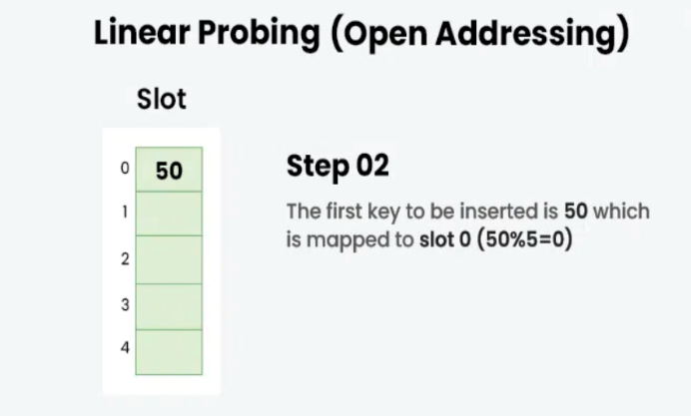
LINEAR PROBING: Example
Hash(Key) = Key % P
Keys: {50, 70, 76, 85, 93}, P = 5

Slide 10
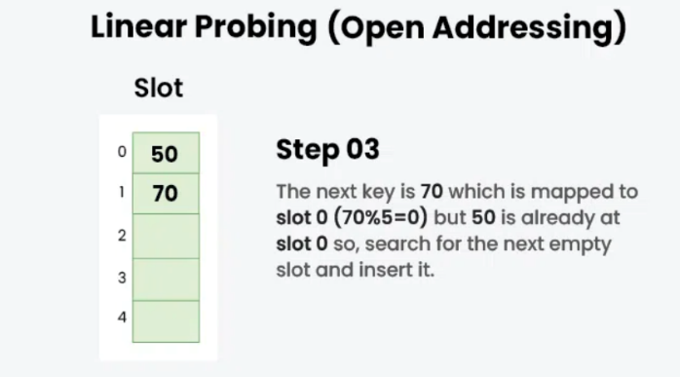
LINEAR PROBING: Example
Hash(Key) = Key % P
Keys: {50, 70, 76, 85, 93}, P = 5

Slide 11
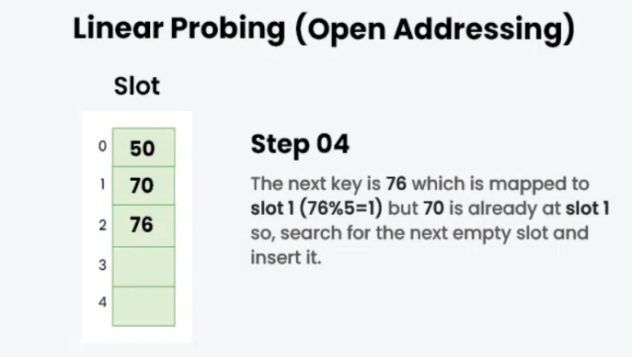
LINEAR PROBING: Example
Hash(Key) = Key % P
Keys: {50, 70, 76, 85, 93}, P = 5

Slide 12
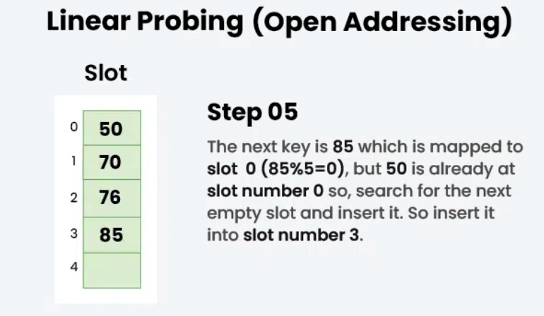
LINEAR PROBING: Example
Hash(Key) = Key % P
Keys: {50, 70, 76, 85, 93}, P = 5

Slide 13
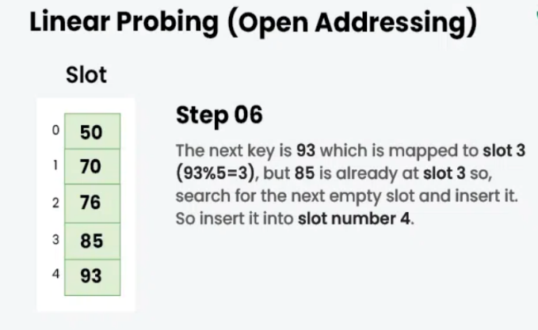
LINEAR PROBING: Example
Hash(Key) = Key % P
Keys: {50, 70, 76, 85, 93}, P = 5

Slide 14
Real-Life Examples of Hashing
Library Indexing: Quickly find books by genre.
Login Systems: Hash passwords for security.
URL Shortening: Long URLs become short unique strings.
Banking Transactions: Account numbers hashed for efficiency.

